Slide 1
Fill In The Gap Productions
An Investigation into Maximizing Domestic Gross
Trevor Bedrin
9/19/2014

Slide 2
The Question
Is it possible to determine the best possible projects for the client to pursue based on very limited data?
Budget
Release Month
Runtime
Genre
MPAA Rating

Slide 3
The Premise
We started with the assumption that there is an underlying relationship between our selected features and the actual Domestic Gross that can be well represented by a linear regression model.

Slide 4
The Result
We ended up with a model that uses a combination of Runtime, Release Month, Genre, and Rating as well as interactions between Genre and Month and Genre and Rating.
Where is Budget? It turns out that removing Budget from the model allows it to predict values that more closely matched the actual Domestic Gross of the test set.
The final model is able to predict, with 95% confidence, the actual Domestic Total Gross +/- $52,155,519.89.
The R² value of the model is 0.354.

Slide 5
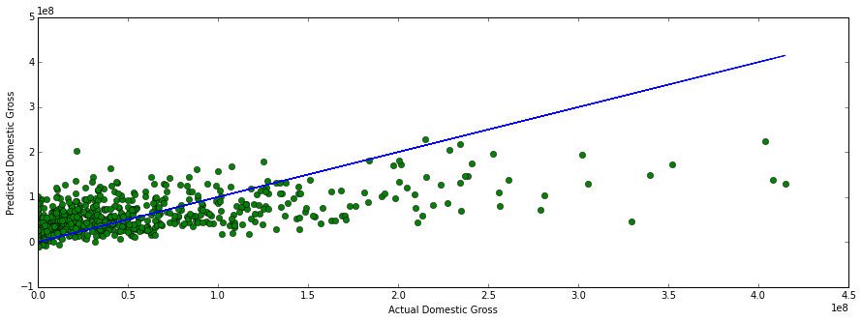
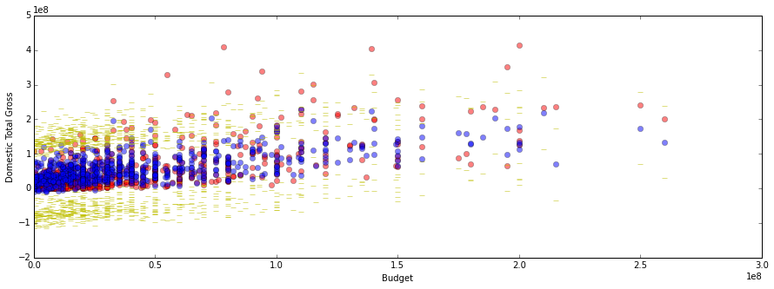
Performance

Slide 6
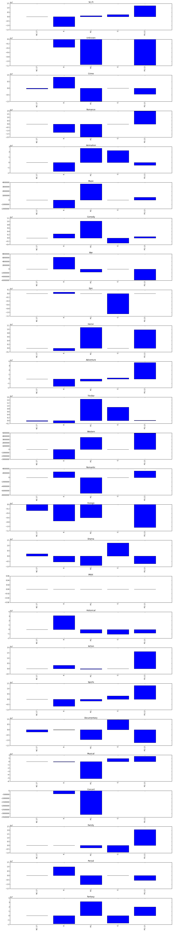
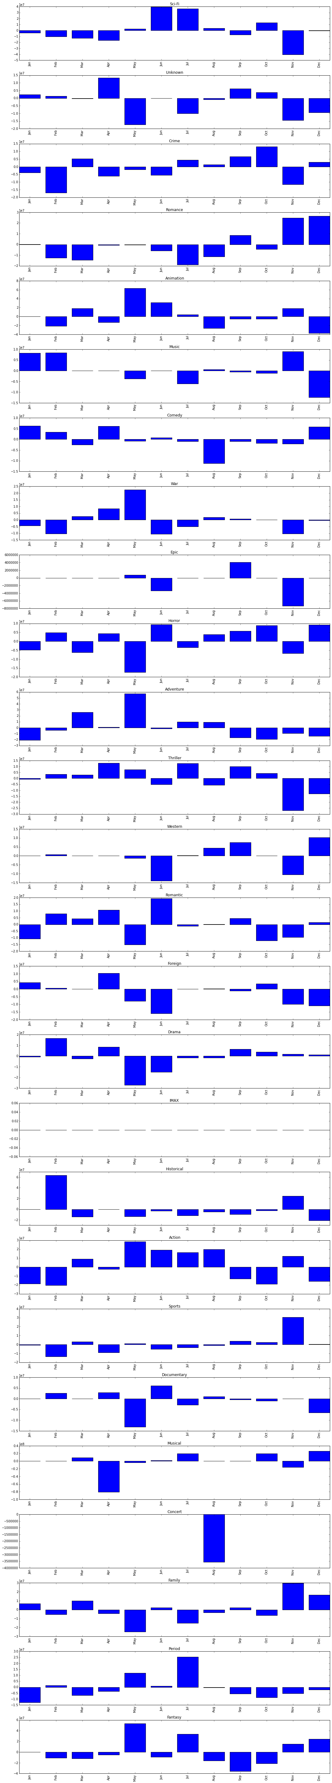
What else do we know?
Rating
Month
Our model used several hundred interaction parameters to get a sense of how different combinations of genre, rating and month affected the outcome.
Because the predicted value of the model is the Domestic Gross, we can use the model to get a sense of how many dollars each parameter actually contributes to the total.
The charts on the right, which are way too small to actually make out in this presentation, plot the value each genre/rating (left chart) or genre/month (right chart)

Slide 7
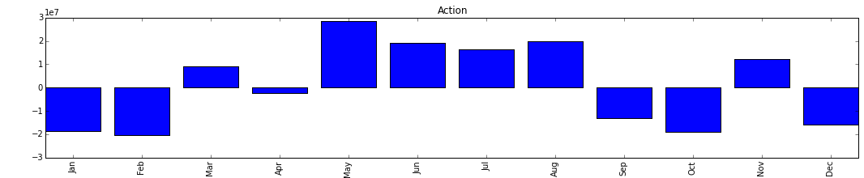
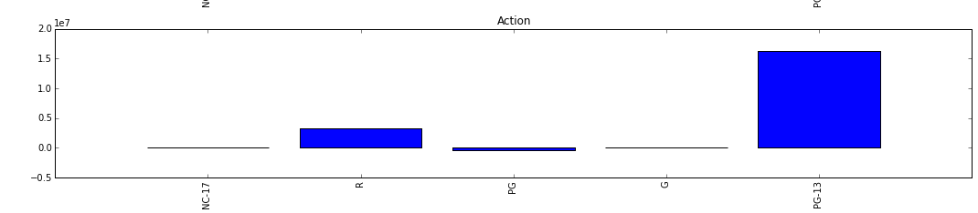
What does this tell us?
How is this useful information? Using these values we can determine the best release month and rating to release a movie of a specific genre. For example, the Action Genre.

Slide 8
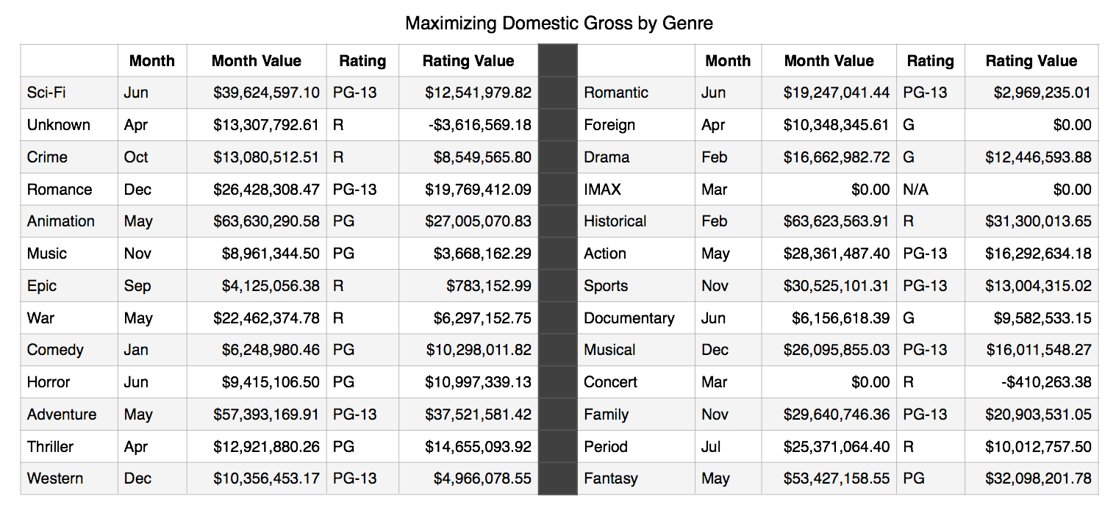
Target These Projects

Slide 9
Moving Forward
With more time to pursue this project it would be possible to pull in additional data points from sources other than Box Office Mojo.
Directors, Producers and Featured Actors are all features that could have a real impact on the predictive ability of the model. The number of other, similar projects slated for release during the same month would also have an affect.
This analysis also only looked at Domestic Gross. Incorporating foreign gross into the model would allow it to much better predict what projects offer the best chance of being profitable.

